Slide 1
Popular Programming Tech
Part 7
Interface

Slide 2
Learning Objective
LO 2 : Apply GO programming language techniques and libraries

Slide 3
Outline
Interface as contracts
Interface types
Interface satisfaction
Parsing flags with flag
Interface values
Sorting with sort
Http handler interface
Error interface
Type assertions

Slide 4
Interface
Interface types express generalizations or abstractions about the behaviors of other types
By generalizing, interfaces let us write functions that are more flexible and adapt able because they are not tied to the details of one particular implementation
Many object-oriented languages have some notion of interfaces, but what makes Go’s interfaces so distinctive is that they are satisfied implicitly
In other words, there’s no need to declare all the interfaces that a given concrete type satisfies

Slide 5
Interfaces as Contracts
All the types we’ve looked at so far have been concrete types
A concrete type specifies the exact representation of its values and exposes the intrinsic operations of that representation, such as arithmetic for numbers, or indexing, append, and range for slices
An interface is an abstract type. It doesn’t expose the representation or internal structure of its values

Slide 6
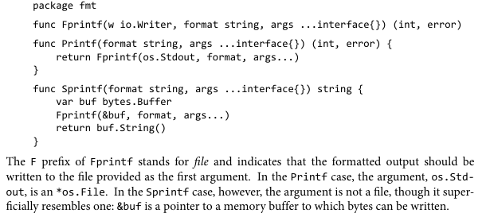

Slide 7
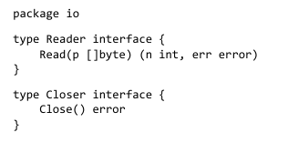
Interface Types
An interface type specifies a set of methods that a concrete type must possess to be considered an instance of that interface.
The io.Writer type is one of the most widely used interfaces because it provides an abstraction of all the types to which bytes can be written, which includes files, memory buffers, network connections, HTTP clients, archivers, hashers, and so on

Slide 8
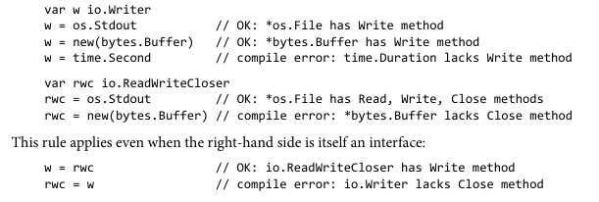
Interface Satisfaction
A type satisfies an interface if it possesses all the methods the interface requires
For example, an *os.File satisfies io.Reader, Writer , Closer, and ReadWriter

Slide 9
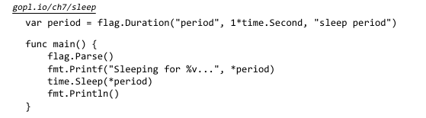
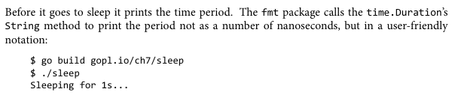
Parsing Flags with flag.Value

Slide 10

Interface Values
Conceptually, a value of an interface type, or interface value, has two components, a concrete type and a value of that type
In Go, variables are always initialized to a well-defined value, and int erfaces are no exception.

Slide 11
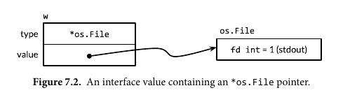

Slide 12
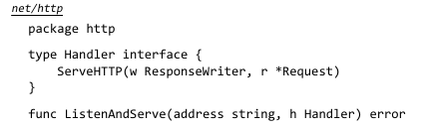
The http.Handler Interface
The ListenAndServe func tion requires a server address, such as "localhost:8000", and an instance of the Handler interface to which all requests should be dispatched

Slide 13

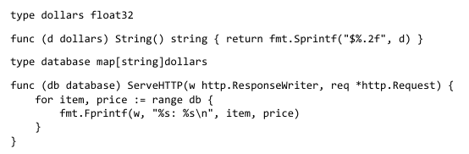
So far, the seRver can only list its entire inventory and will do this for every request, regardless of URL. A more realistic server defines multiple different URLs, each triggering a different behavior. Let’s call the existing one /list and add another one called /price that reports the price of a single item, specified as a request parameter like /price?item=socks.

Slide 14
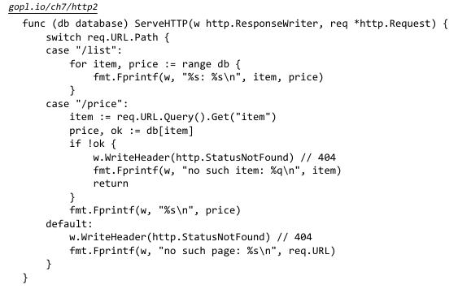
Now the handler decides what logic to execut e based on the path component of the URL, req.URL.Path. If the handler doesn’t recognize the pat h, it reports an HTTP error to the client by calling w.WriteHeader(http.StatusNotFound); this must be done before writing any text to w. (Incidentally, http.ResponseWriter is another interface. It augments io.Writer with methods for sending HTTP response headers.)

Slide 15
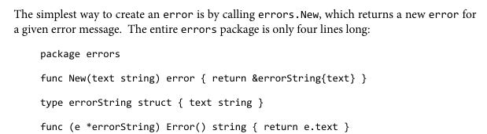
The Error Interface

Slide 16
Type Assertions
A ty pe assertion is an operation applied to an interface value
Syntactically, it looks like x.(T), where x is an expression of an interface type and T is a type, called the ‘asserted’’ type
A type assertion checks that the dynamic type of its operand matches the asserted type.
There are two possibilities. First, if the asserted type T is a concrete type, then the type assertion checks whether x’s dynamic type is identical to T
Second, if instead the asserted type T is an interface type, then the type assertion checks whet her x’s dynamic type satisfies T. If this check succeeds, the dynamic value is not extracted

Slide 17
References
https://www.geeksforgeeks.org/interfaces-in-golang/
https://gobyexample.com/interfaces

